Slide 1
Anomaly Detection in Time Series Data using LSTM
Madhavendra Rathore

Slide 2
Introduction
An Anomaly is a data point in observation that differs significantly from the rest of the data points.
Anomalies can occur due to measurement errors, sensor malfunctions, cyber-attacks, etc.
Detection of these anomalies is essential in many fields as it can help identify problems that would have gone unnoticed with traditional monitoring methods.

Slide 3
Outlier Detection in Time Series
Time series outlier detection aims to identify unexpected or rare instances in data.
Outliers can be of different types:
Point-wise outliers
Pattern-wise outliers
The identification of these outliers with the help of LSTM would help identify fraud or malicious activities.

Slide 4
Dataset
The dataset used for the project is the Numenta Anomaly Benchmark(NAB) which consists of different types of time series data.
The dataset had a variety of artificial anomalies, including different types of group anomalies and point anomalies.
The model was also implemented on a Twitter dataset, showing the count of tweets regarding a company on specific time stamps.

Slide 5
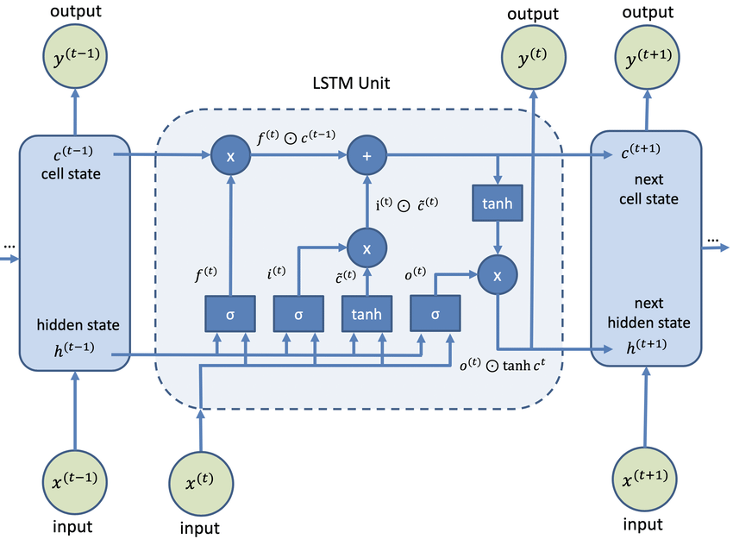
LSTM
LSTM model tackles the vanishing gradient problem in time series data.
It helps retain the data inferences for long and helps predict future values.
The model looks at the previous values over a time frame and predicts the behaviour using LSTM layers.

Slide 6
Model
The data was split into training and testing data in different ratios for different datasets.
The data was scaled using standard scaler.
The model has 2 x LSTM layers of 128 hidden neurons each, 20 times, and batch size of 64.
Adam optimizer was then used along with loss parameter as ‘Mae’.

Slide 7
Threshold
The model defines a threshold beyond which the instance can be considered an anomaly.
The training data loss was calculated by taking absolute difference from predicted value and the actual value.
The maximum of training data loss is considered threshold in some datasets depending on the results.
Threshold identification was the key part of the project because it’s a trade-off between finding more actual anomalies or missing out on some anomalies.

Slide 8
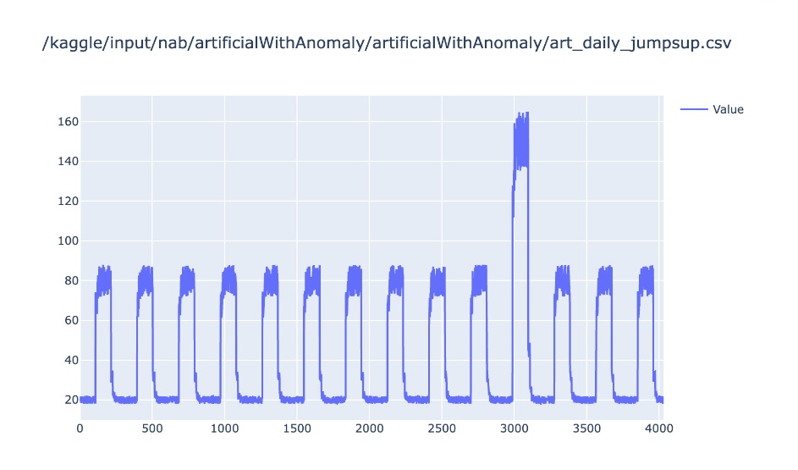
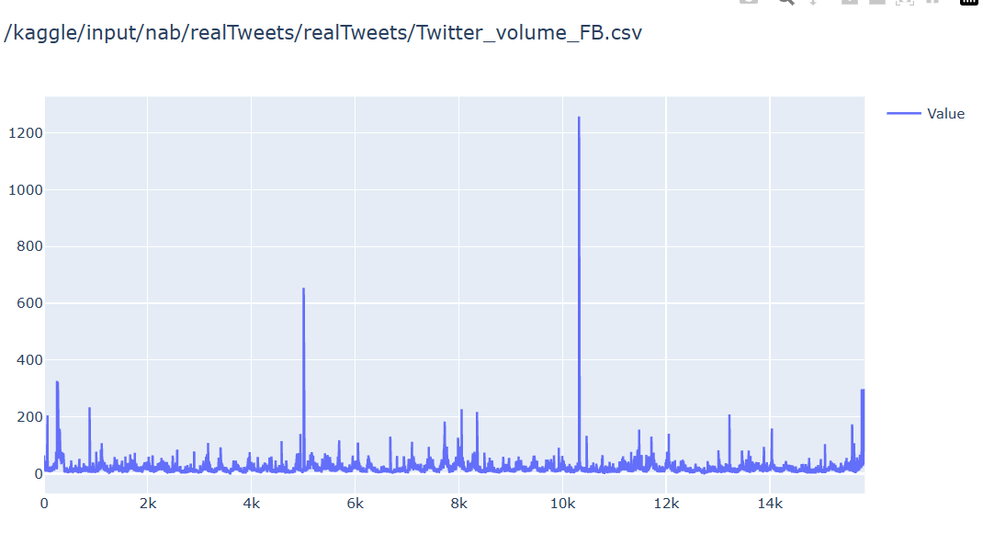
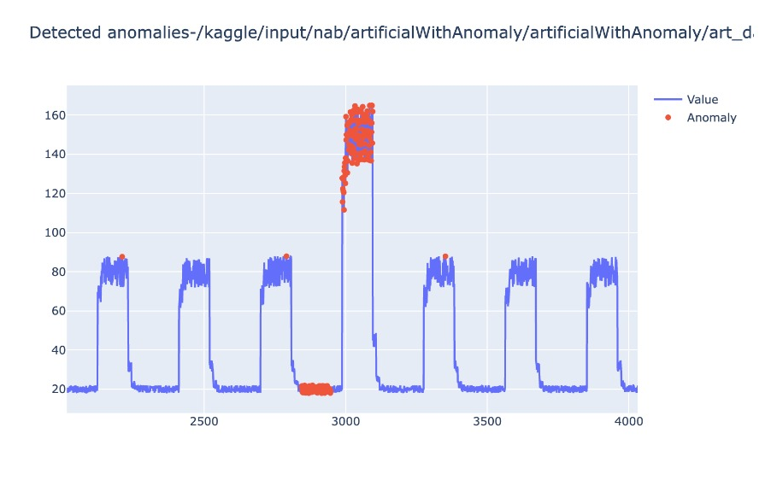
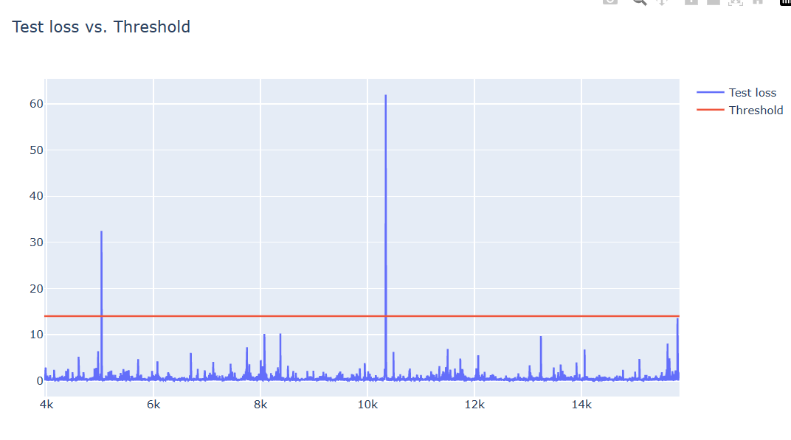
Results

Slide 9
F1 scores
Flat line dataset-0.59
Jump-down dataset-0.58
Jump up dataset-0.69
Tweet CVS dataset-0.7
Speed6005 dataset- 0.50

Slide 10
Conclusion
The project worked on finding anomalies in time-series data which was indeed a very tedious task.
The accuracy depends a lot on the thresholds that are chosen for the datasets because thresholds vary.
The model works better on point anomalies than on collective anomalies.

